Slide 1


SQL & Distributed DBMS
SE3331-1 (2022 Fall)
Xingda Wei
IPADS, Shanghai Jiao Tong University
https://www.sjtu.edu.cn

Slide 2

Review: Abstraction of the operations: replicated log
Clients
shl
Consensus Module
State Machine
Consensus Module
State Machine
Consensus Module
State Machine
Servers
Log
Log
Log
add
jmp
mov
shl
add
jmp
mov
shl
add
jmp
mov
shl
Replicated log => replicated state machine
All servers execute same (deterministic) commands in same order
Consensus module ensures proper logs are the same!

Slide 3
Review: Raft replicated log
A different approach for consensus
Paxos’s approach (bottom-up)
solve single-decree consensus first
replicate a sequence of values using single-decree consensus
Raft’s approach (top-down)
directly solve log replication without first solving single-decree consensus

Slide 4
Raft’s high-level approach: problem decomposition
Leader election
Select one server as the leader
Detect crashes, choose new leader
Log replication (normal operation)
Leader accepts commands from clients, append to its log
Leader replicates its log to other servers (overwrites inconsistencies)
Safety
Keep logs consistent
Only servers with up-to-date logs can become the leader
Notes:
Safety can violate if a replication happens partially

Slide 5
Raft server states
Server
Server
Network
At any time, each server is either:
Leader: handles all client interactions, log replication
Invariant: At most 1 viable leader at a time
Follower: passive (only responds to incoming RPCs)
Candidate: used to elect a new leader
Normal workloads
1 server is the leader, others are the followers
Server
Servers communicates
w/ RPCs
Timeout, start election
Receive acks from majority of servers
Start
Follower
Candidate
Leader
Discover current server or
w/ high term
Discover server w/ high term

Slide 6
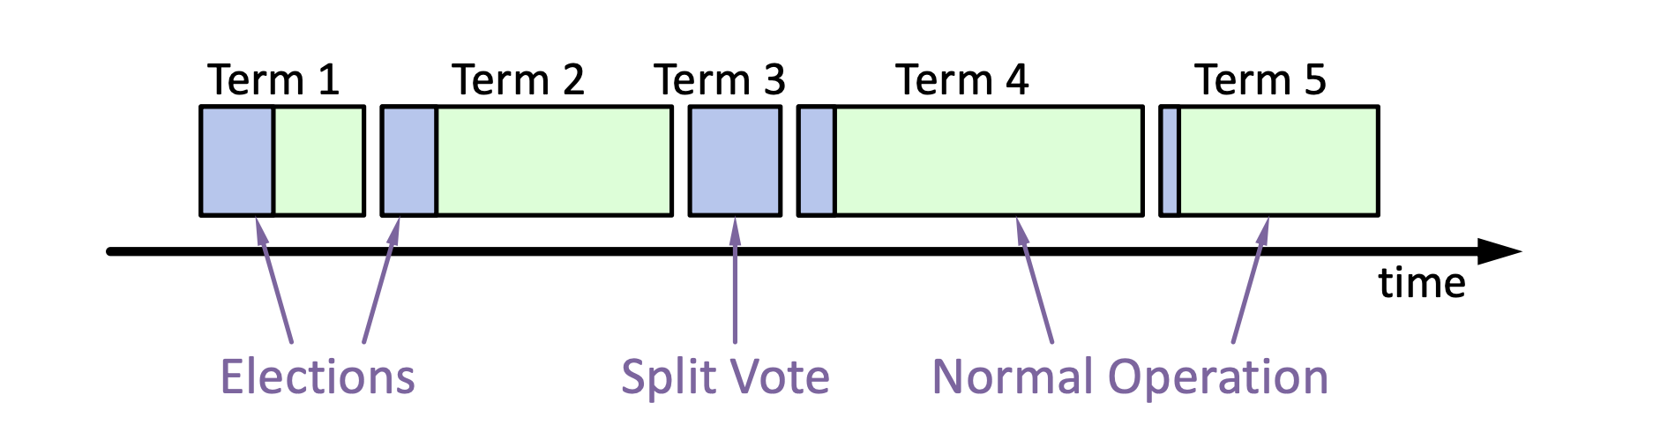
Raft basics: terms
Raft divides time into terms (w/ arbitrary length):
Each term starts w/ an election
Ends with one leader or no leader
At most one leader per term
Each leader is uniquely associated w/ a term
Key role: identify obsolete information
Notes:
obsolete information, e.g., as stale leaders
Servers exchange with others to build the global view of the terms

Slide 7
Review: Election Basics
If a follower detects a leader is crash (heartbeat timeout):
Change its state to the candidate state
Increment current term
Vote for itself
Send RequestVote RPCs to all other servers, retry until either
Receive votes from majority of servers ➔ Become the leader!
Receiver RPC from a valid leader ➔ Return to the follower
No one wins election (timeouts on the election) ➔ Increase the term, start the new election

Slide 8
Persistent state of each server + log
currentTerm
Latest term server has seen (initialized to 0 on first boot)
votedFor
Candidate Id that received vote in current term (or null if none)
Log[]
Log entries

Slide 9
Basic request vote RPC so far
Invoked by candidates to gather votes.
Arguments:
candidateId candidate requesting vote
term candidate's term
Results:
term currentTerm, for candidate to update itself
voteGranted true means candidate received vote
Implementation:
If term > currentTerm, currentTerm ← term//这种情况就是已经有一个新的term了 (step down if leader or candidate)
If term == currentTerm, votedFor is null or equal to candidateId, grant vote and reset election timeout
Notes:
votedFor要修改的，只是论文里没写

Slide 10
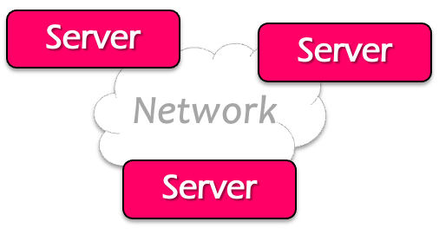

Normal operations (append log entry) of raft
Command
Client
Send command to the leader
Leader appends command to its log
Leader sends AppendEntries RPCs to followers
Once a new entry (of log) committed:
Leader passes command to its state machine, returns results to client
Notifies followers of committed entries, Follower pass committed commands to their state machines
We will talk about how to
decide committed later

Slide 11
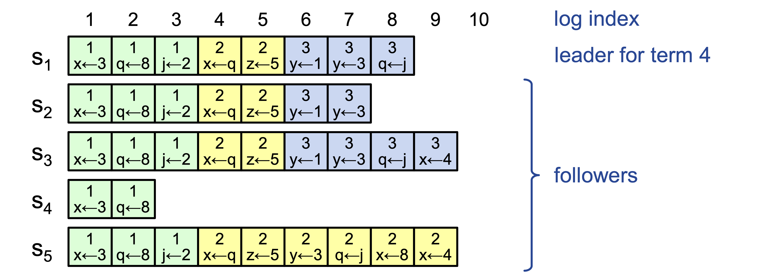
Challenge: crash can cause log to inconsistencies
Raft must repair logs in case of inconsistency
Leaders assume its log is correct
Leaders use normal operation to repair all inconsistencies
Notes:
Case in the example: server 4 crashes
Server 5 becomes the leader for 2, and keeps appending the logs from the clients

Slide 12

Example: log inconsistency
Case: an old leader is unaware of the new leader due to network partition
Yet, it can still get commands from the clients
Leader
Leader
Leader (stale)
S1
1
add
1
cmp
S1
1
add
1
cmp
1
xxx
S1
1
add
1
cmp
1
xxx
S2
1
add
1
cmp
S2
1
add
1
cmp
S2
1
add
1
cmp
2
shi
S3
1
add
1
cmp
S3
1
add
1
cmp
S3
1
add
1
cmp
2
shi
2
ret
Leader (term2)
Term 1
Term 2

Slide 13
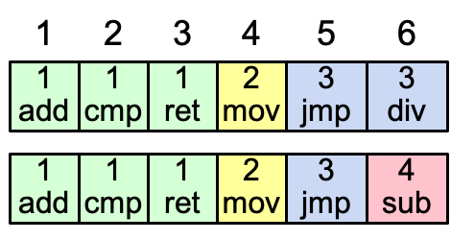
Consistency of the log
Question: how to achieve this property?
High level of coherency between logs maintained by the raft:
If log entries on different servers have the same index & term
They store the same command
The logs are identical in all preceding entries
If a given entry is committed, all preceding entries are also committed
Note that not all log entries are committed
Notes:
Commands must be equal: issued by the same leader

Slide 14
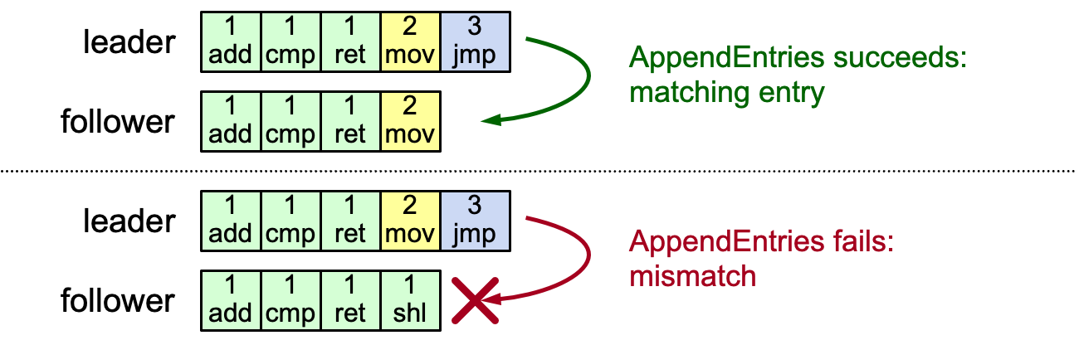
AppendEntries consistency checks
Each RPC argument contains
Append index, term, term of entry preceding new ones
Follower checks whether it has the matching entry
Otherwise, it rejects the request

Slide 15
Handle rejections: no special operations
In this example, the leader will retry AppendEntries on the previous entry
Overwrite index 4 with [2 mov] with AppendEntries
Then append entry [3 jmp] to the end of the follower
Fail to append case
Overwrite mismatched entry
L
1
add
1
cmp
1
ret
2
mov
3
jmp
L
1
add
1
cmp
1
ret
2
mov
3
jmp
1
ret
2
mov
F
1
add
1
cmp
1
ret
1
shi
F
1
add
1
cmp
1
shi
L
1
add
1
cmp
1
ret
2
mov
3
jmp
Append the new entry
1
ret
2
mov
3
jmp
F
1
add
1
cmp
1
shi

Slide 16
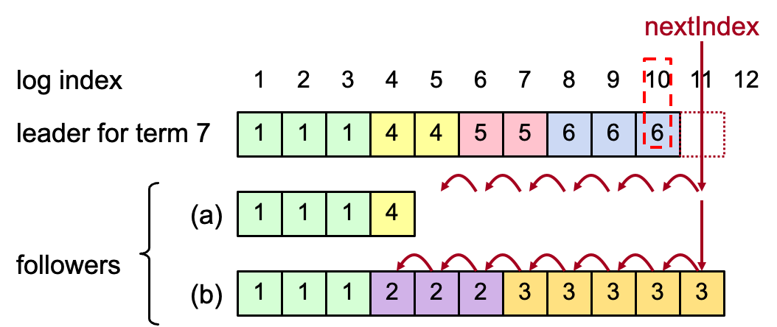
Handle rejections can be iterative
New leader must make follower logs consistent with its own
Delete extraneous entries
Fill in missing entries
Leader keeps nextIndex for each follower:
Index of next log entry to send to that follower
Initialized to (1 + leader’s last index)

Slide 17
AppendEntries RPC (Simplified)
Invoked by leader to replicate log entries and discover inconsistencies
Arguments:
term leader's term
prevLogIndex index of log entry immediately preceding new ones
prevLogTerm term of prevLogIndex entry
entries[] log entries to store (empty for heartbeat)
Results:
success true if follower contained entry matching prevLogIndex and prevLogTerm
Notes:
省去了heartbeat和commmit

Slide 18
AppendEntries RPC (Simplified)
Implementation:
Return false if term < currentTerm
If term > currentTerm, currentTerm ← term
If candidate or leader, step down
Reset election timeout
Return failure if log doesn’t contain an entry at prevLogIndex whose term matches prevLogTerm
If existing entries conflict with new entries, delete all existing entries starting with first conflicting entry
Append any new entries not already in the log
Notes:
省去了heartbeat和commmit

Slide 19
Question
Since our log is consistent, when can we apply the log entry to the state machine?
a.k.a., log entry seemed as committed

Slide 20
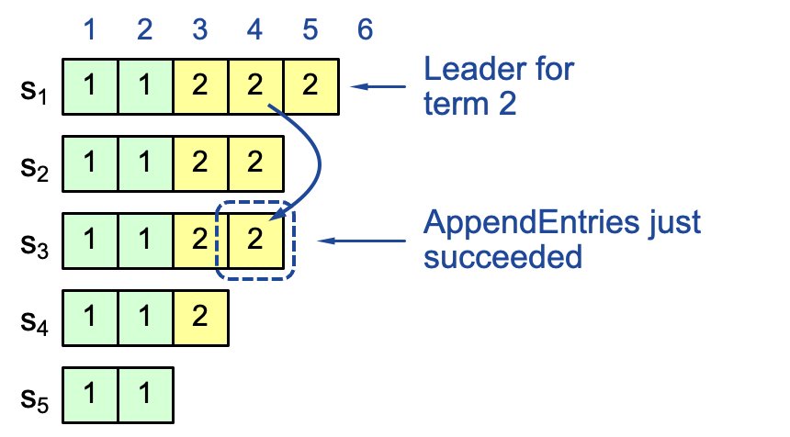
Intuitive result: replicating on a majority
If the log is replicated on a majority of servers, it can be replicated on the state machine
Not always true on raft so far
Question: can index 4 be overwritten after appending to S3?

Slide 21
Case study: raft overwriting
Question: can index 4
be overwritten?
Leader S1
Leader ?
Leader S2
1
2
3
4
1
2
3
4
1
2
3
4
s₁
1
1
2
2
2
s₁
1
1
2
2
2
1
1
2
2
s₂
1
1
2
2
s₂
1
1
2
2
s₂
1
1
2
2
s₃
1
1
2
2
s₃
1
1
2
2
3
s₃
1
1
2
s₄
1
1
2
s₄
1
1
2
s₄
1
1
s₅
1
1
s₅
1
1
s₅
Term 2
S1 crashes
Term 3

Slide 22
Case study: raft overwriting
Question: can index 4
be overwritten?
Leader S1
Leader ?
Leader S5
1
2
3
4
1
2
3
4
1
2
3
4
s₁
1
1
2
2
2
s₁
1
1
2
2
2
1
1
2
2
1
1
2
2
s₂
1
1
2
2
s₂
3
s₂
1
1
2
2
1
1
2
2
s₃
1
1
2
2
s₃
3
s₃
1
1
3
1
1
2
s₄
1
1
2
s₄
2
s₄
1
1
s₅
1
1
s₅
1
1
3
3
s₅
Term 2
S1 crashes
Term 3

Slide 23
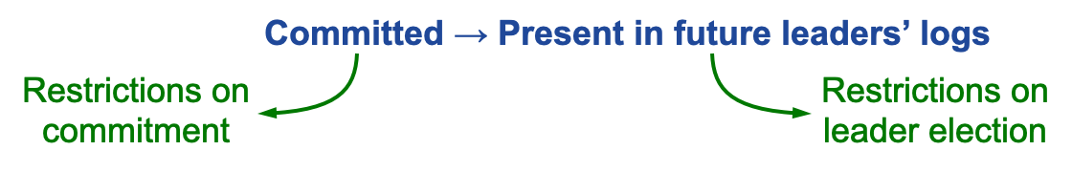
Safety requirement of the commit entry
Raft safety property:
If a leader has decided that a log entry is committed, that entry will be present in the logs of all future leaders (not being overwritten)
This guarantees the safety requirement
Leaders never overwrite entries in their logs
Only entries in the leader’s log can be committed
Entries must be committed before applying to state machine
We should help the leader deciding which its entry cannot be overwritten
Notes:
1. Delay the commitment of an entry until we know it is committed

Slide 24
Committing Entry from the Current Term
Goal: if the entry is replicated on a majority, it cannot be overwritten
Question: how to prevent index 4 from being overwritten? Prevent S4 or S5 from becoming the leader

Slide 25
Picking the Best Leader
During elections, choose candidate with log most likely to contain all committed entries
Candidates include log info in RequestVote RPCs (index & term of last log entry)
Voting server V denies vote if its log is “more complete”: (lastTermV > lastTermC) || (lastTermV == lastTermC) && (lastIndexV > lastIndexC)
Leader will have “most complete” log among electing majority
Question: which log is longer?
S1 & S2, respectively
s₁
1
1
2
2
2
s₁
1
1
2
2
2
s₂
1
1
2
2
s₂
1
1
2
3

Slide 26
Complete picture of request vote RPC
Invoked by candidates to gather votes.
Arguments:
candidateId candidate requesting vote
term candidate's term
lastLogIndex index of candidate's last log entry
lastLogTerm term of candidate's last log entry
Results:
term currentTerm, for candidate to update itself
voteGranted true means candidate received vote
Implementation:
If term > currentTerm, currentTerm ← term (step down if leader or candidate)
If term == currentTerm, votedFor is null or candidateId, and candidate's log is at least as complete as local log, grant vote and reset election timeout

Slide 27
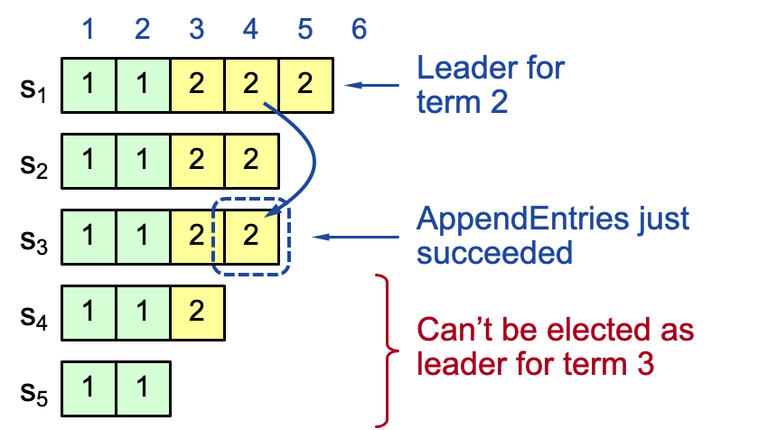
Committing Entry from the Current Term
With leader election rule, if the entry from the same term is replicated on a majority, it cannot be overwritten
Safe: leader for term 3 must contain entry 4

Slide 28
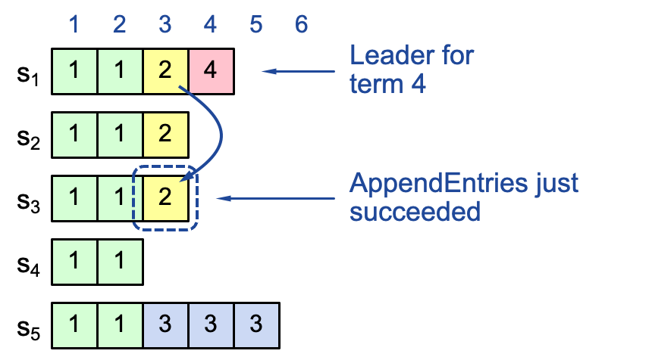
Commit rule for raft so far
If the log entry from the leader term is replicated to a majority of followers
Then we can treat it as committed
The later leader must contain the entry
But, what about replicating log entry from a previous term?
The previous term’s entry may fail to reach a majority

Slide 29
Case study: a majority replicated entry can be overwritten
Leader S1
Leader S5
Question: who can become the leader for term 3?
S3, S4 & S5
1
2
3
1
2
3
1
2
3
4
s₁
1
1
2
s₁
1
1
2
1
1
2
s₂
1
1
2
s₂
1
1
2
1
1
2
s₃
1
1
s₃
1
1
1
1
Partition happesn after
S5 becomes the leader
s₄
1
1
s₄
1
1
1
1
s₅
1
1
s₅
1
1
1
1
3
3
Partition again!!!
Term 2
Partition!!!
Term 3

Slide 30
Case study: a majority replicated entry can be overwritten
Question: who can become the leader for term 4?
S1 & S2
Question: who can become the leader for term 5?
S2,S3,S5!!!
Leader S5
Leader S1
Leader S5
1
2
3
4
1
2
3
4
5
1
2
3
4
1
1
2
1
1
2
4
1
1
2
1
1
2
1
1
2
1
1
2
3
1
1
1
1
2
1
1
2
1
1
3
1
1
1
1
1
1
1
1
3
1
1
3
3
1
1
3
3
3
1
1
3
3
3
1
1
3
3
3
Partition on term 3!!
Term 4
S1 crashes
Term 5

Slide 31
Committing Entry from Earlier Term
Case #2/2: Leader is trying to finish committing entry from an earlier term
Entry 3 not safely committed:
S5 can still be elected as leader for term 5
If elected, it will overwrite entry 3 on S1, S2 and S3 (recall our previous example)

Slide 32
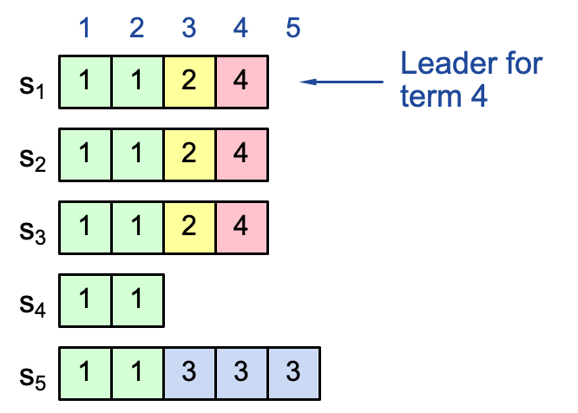
New commitment rules
For a leader to decide an (previous) entry is committed:
Must be stored on a majority of servers
At least one new entry from leader’s term must also be stored on majority of servers
This is because once entry 4 committed:
s₅ cannot be elected leader for term 5
Entries 3 and 4 both safe
Combination of election rules & commitment rules makes Raft safe

Slide 33

Distributed Transaction & Replications
Caching server
Caching server
…
Caching server
Caching
Caching
Caching
Distributed caching
Database server
Database server
CDN
Users
Application #1
generate the page
Database
user, price
…
Database
user, price
Application server
Distributed database
Internet
Load
Balance
Application #2
add the order
File server
File server
File server
File:
image
File:
image
…
File:
image
Application server
…
…
Message queue
Distributed file system

Slide 34
The case for distributed database

Slide 35
Review of properties required by distributed systems
All or nothing atomicity
An action is atomic if happens completely or not at all
transfer(bank, a, b, amt):
bank[a] = bank[a] – amt
bank[b] = bank[b] + amt
Tools: Shadow copy, WAL
Tools: 2PC, OCC & MVCC
Before or after atomicity
Concurrent actions have the before-or-after property if their effect from the point of view of their invokers is as if the actions occurred either completely before or completely after one another
Deposit(bank, acct, amt):
bank[acct] += amt
Deposit(bank, acct, amt):
bank[acct] += amt

Slide 36
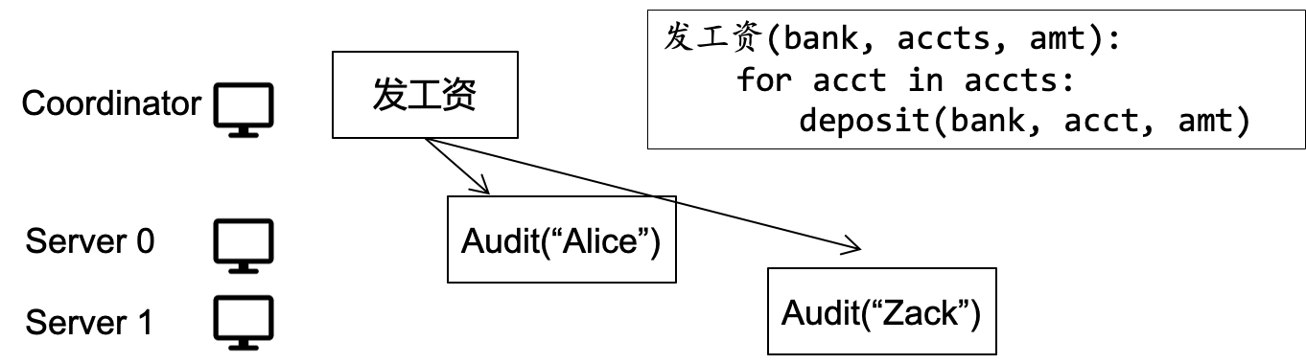
Review of properties required by distributed systems
Atomicity across multiple transactions and multiple sites
Tools: 2PC

Slide 37
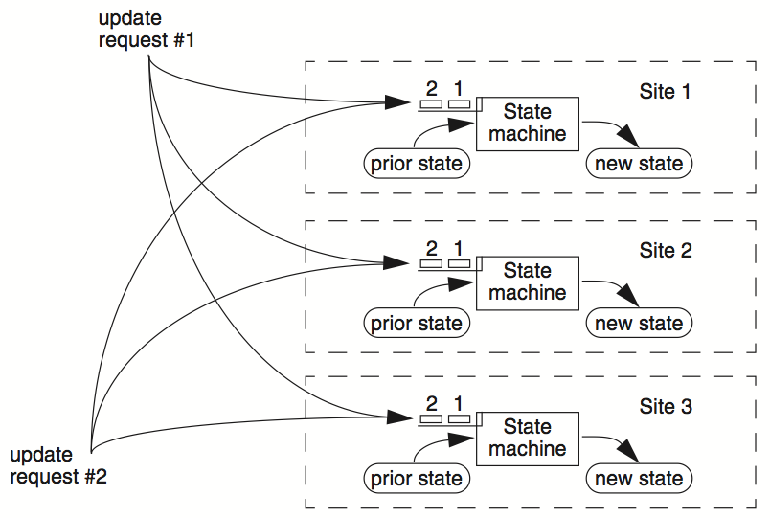
Review of properties required by distributed systems
Atomicity across multiple replications
E.g., replicated state machine
Tools: Paxos, Raft

Slide 38
Question
What are the major API for accessing states during computation?
Key value store API !
Data layout:
Key → Sequence of bytes
Value → Sequences of bytes
Interface
Get(K) -> V
Put(K,V)
Insert(K,V)
Etc.
Deposit(bank, acct, amt):
bank[acct] += amt
v = bank.Get(acct)
bank.Put(acct, v + amt)

Slide 39
Does key-value API sufficient?

Slide 40








Example: modeling real-world data
Suppose we want to support a simple shopping website
What entities shall we store?
Information of items
Information of providers
etc.
We should also store the relationship between the above entities
E.g., which provider an item belongs to
Example implementation: using key-value stores
One to store items, key: item name, value: a c++ struct describing the item
One to store the providers : provider name, value: a c++ struct describing the provider

Slide 41
Challenge: data management efficiency
How to find a particular record efficiently?
E.g., the item named “ipad pro 12.9”?
Easy: use key-value storage

Slide 42
Challenge: data management efficiency
How to find a particular record efficiently?
E.g., the item named “ipad pro 12.9”?
E.g., find the items released in 2021?
Easy: use key-value storage
Not so easy aha

Slide 43
Challenge: data management efficiency
How to find a particular record efficiently?
E.g., the item named “ipad pro 12.9”?
E.g., find the items released in 2021?
Similarly, how to find the joined results of different records?
E.g., finding all the items released by Apple?
Easy: use key-value storage
Not so easy aha

Slide 44
Challenge: data integrity checks
How to prevent malicious updates to the database?
E.g., insert an item named: (ipad pro, Apple, 2049)
For key-value API, we must manually implement it
For each case we must consider
For complex applications, we must consider need the API to be more expressiveness!
inserted_value = ...; // something from user
if inserted_value.year > 2021:
report an error
kv_item.insert(key,inserted_value);
That is the implementation

Slide 45
Data models & query language

Slide 46
Data models of computing systems
Data model: collection of concepts for describing the data in a database
Schema: a description of a particular collection of data, using a given data model
Example data model:
Relational
Key-value
Graph
Document
...
Though some models are more nature in specific workloads
E.g., the graph data model is more natural for graph workloads
More expressiveness

Slide 47
Principle: be declarative, not procedural
Declarative: knowledge of
Example: ”Stop at the red traffic light”
Procedural: knowledge of how
Example: “play a song”
Example: “Write a program to forbid malicious insertions”
In psychology, declarative language is easier to learn
Procedural knowledge needs many practices
E.g., you have to code 10,000+ LoC to be a good c++ programmer

Slide 48
The relation model
Concepts:
Relation(table): an unordered set that contain the relationship of attributes that represent entities
Tuple(row): a set of attribute values in the relation
Item (name, provider, year)
Name | Provider | Year
ipad pro | Apple | 2021
iphone | Apple | 2021
N-ary Relation
=
Table with N columns
Notes:
Declarative query lanaguage for relational databases. It was originally developed in the 1970s as part of the IBM System R project. IBM originally called it “SEQUEL” (Structured English Query Language). The name changed in the 1980s to just “SQL” (Structured Query Language).

Slide 49
Use tables and rows to represent relation
Concepts:
Relation(table): an unordered set that contain the relationship of attributes that represent entities
Tuple(row): a set of attribute values in the relation
Tuple
Values are (normally) atomic/scalar
Values belong to some domain (e.g., int)
A special value NULL for every domain
Item (name, provider, year)
Name | Provider | Year
ipad pro | Apple | 2021
iphone | Apple | 2021
Notes:
Exception: json. Some DB allows to store a json as its attribute

Slide 50
The relational model
CREATE TABLE Item ( Provider string NOT NULL ,
Year int NOT NULL,
..., )
Tuple(row)
Values are (normally) atomic/scalar
Values belong to some domain (e.g., int)
A special value NULL for every domain
Why specifying a domain?
Recall the data integrity problem of key-value: how to cope with insertions like:
(ipad pro, Apple, 2049) ?
Item (name, provider, year)
Name | Provider | Year
ipad pro | Apple | 2021
iphone | Apple | 2021
Notes:
CREATE TABLE Item (Name VARCHAR(255) NOT NULL, Provider VARCHAR(255) NOT NULL, Year int NOT NULL )
INSERT INTO Item ( Name, Provider,Year )
VALUES
( "ipad pro", "apple", 2049 );
CREATE TABLE Item (Name VARCHAR(255) NOT NULL, Provider VARCHAR(255) NOT NULL, Year int NOT NULL
CONSTRAINT Year_Ck CHECK (Year BETWEEN 1940 AND 2021)
)

Slide 51
The relational model vs. key-value
Why specifying a domain?
Recall the data integrity problem of key-value: how to cope with insertions like:
(ipad pro, Apple, 2049) ?
Suppose we are using a key-value store
Key -> “ipad pro”, value -> {provider: “Apple”,”Year : 2049 }
inserted_value = ...; // something from user
if inserted_value.year > 2021:
report an error
kv_item.insert(key,inserted_value);
That is the procedural implementation
Notes:
CREATE TABLE Item (Name VARCHAR(255) NOT NULL, Provider VARCHAR(255) NOT NULL, Year int NOT NULL )
INSERT INTO Item ( Name, Provider,Year )
VALUES
( "ipad pro", "apple", 2049 );
CREATE TABLE Item (Name VARCHAR(255) NOT NULL, Provider VARCHAR(255) NOT NULL, Year int NOT NULL
CONSTRAINT Year_Ck CHECK (Year BETWEEN 1940 AND 2021)
)

Slide 52
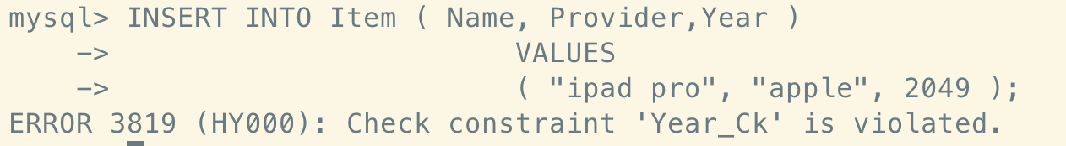
The relational model vs. key-value
Why specifying a domain?
Recall: data integrity problem of key-value: how to cope with insertions like:
(ipad pro, Apple, 2049) ?
Relational model allows you to set a constraint declaratively
Specific the domain of a value
What if you insert a wrong value?
CREATE TABLE Item ( Provider string NOT NULL ,
Year int NOT NULL,
...,
CONSTRAINT Year_Ck CHECK (Year BETWEEN 1940 AND 2022) )
That is the declaration

Slide 53
Modeling relationship between data
E.g., "an item belongs to a provider"
Should check that the provider in an item is a valid provider!
Does key-value store provide these checks?
No. Application developers should implement this by themselves
inserted_value = ...; // something from user
if kv_provider.get(inserted_value) == NULL:
report an error
kv_item.insert(key,inserted_value);
This is the procedural implementation

Slide 54
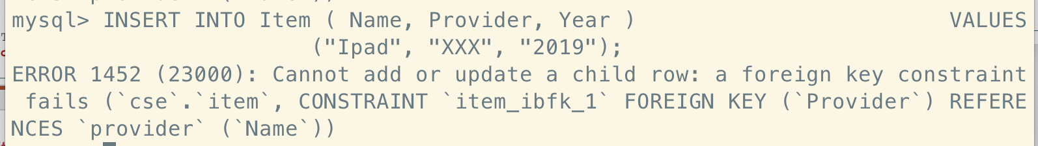
Modeling relationship with relational model
E.g., an item belongs to a provider
Relational model adds a concept of foreign key
Item (name, provider, year)
Provider (name, country)
Name | Provider | Year
ipad pro | Apple | 2021
iphone | Apple | 2021
Name | Country
Apple | USA
Huawei | China
CREATE TABLE Item ( Provider string NOT NULL ,..., FOREIGN KEY (Provider) REFERENCES Provider(Name) )
This is the declaration
Notes:
CREATE TABLE Provider (Name VARCHAR(255) NOT NULL, Country VARCHAR(255) NOT NULL );
CREATE TABLE Item (Name VARCHAR(255) NOT NULL, Provider VARCHAR(255) NOT NULL, Year int NOT NULL
CONSTRAINT Year_Ck CHECK (Year BETWEEN 1940 AND 2021),
FOREIGN KEY (Provider)
REFERENCES Provider(Name)
)
INSERT INTO Item ( Name, Provider, Year )
VALUES
("Ipad", "XXX", "2019")

Slide 55

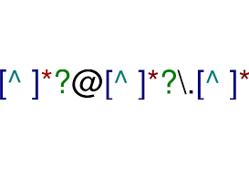


Relational model vs. key-value model
Declarative vs. procedural
Which one is better?
Declarative
You say what you want without having to say how to do it
Example:
Procedural
You have to specify exact steps to get the result
Example:
Notes:
Procedure: c, c++
Declarative; SQL, regular expression

Slide 56
The relational model is a superset of key-value
Recall: key-value model
Get(key) -> value
How can we model this query with relational model?
Primary key! An attribute that uniquely identifies the tuple in a table
CREATE TABLE Item ( Provider string NOT NULL ,..., FOREIGN KEY (Provider) REFERENCES Provider(Name)
PRIMARY KEY (Name),
ON DELETE CASCADE )
Item (name, provider, year)
Name | Provider | Year
ipad pro | Apple | 2021
iphone | Apple | 2021
Primary key
Value

Slide 57
Data models & query language

Slide 58

Declare the data developer want with relational algebra
How to describe the data the developer want?
Using natural language?
No. Natural language is not precise
Must be more formal!

Slide 59
Relational algebra
Query in relational model is based on relational algebra
Fundamental operations to retrieve and manipulate tuples in a relation
Based on set algebra
Each operator takes one or more relations as its inputs and outputs a new relation
We can "chain" operators together to create more complex operations
σ
Select
∪
Union
-
Difference
⋈
Join
Π
Projection
∩
Intersection
x
Product

Slide 60
Relational model & SQL
CREATE TABLE Item ( Provider string NOT NULL ,..., FOREIGN KEY (Provider) REFERENCES Provider(Name) )
Relational model is a theoretical proposal
Proposed by Edgar Codd in 1970
What we have presented is actually SQL
SQL is the best-known data model today, which is based on relational model
SQL tables <-> relations
SQL rows <-> tuples
Hence, RDBMS (relational database management system) & SQL had become the choice for many years
And they scale well in a lot of application scenarios
SQL

Slide 61
Example: Using SQL to query the data
Example: returns the item and its provider’s country
How to query the data with the key-value store model ?
result = []
for k,v in kv_item:
provider = Provider.get(v.provider)
result.append(v + provider.country)
print(result)
This is the procedural implementation
Name | Provider | Year
ipad pro | Apple | 2021
iphone | Apple | 2021
... | ... | ...
Name | Country
Apple | USA
Huawei | China

Slide 62
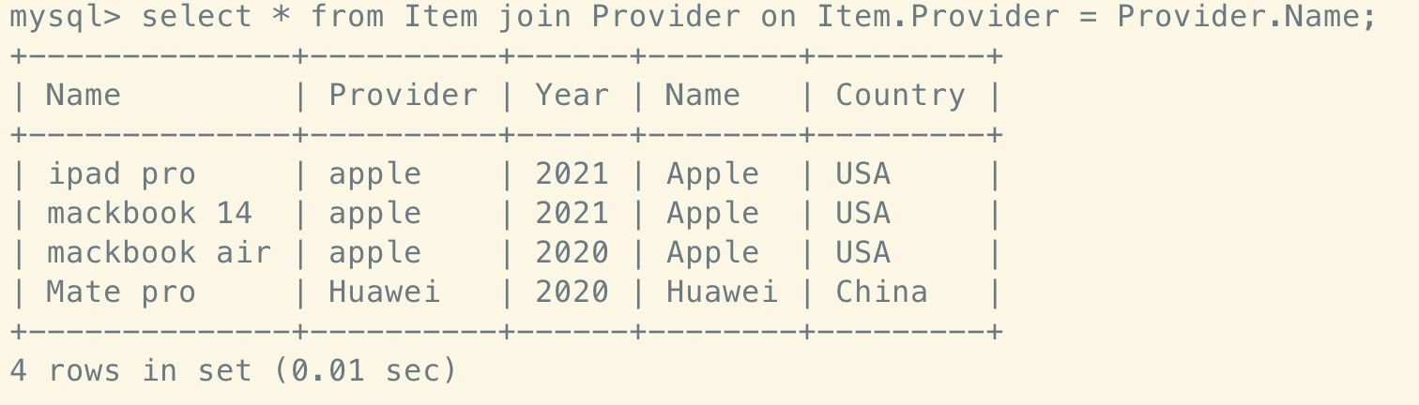
Example: Using SQL to query the data
Name | Provider | Year
ipad pro | Apple | 2021
iphone | Apple | 2021
... | ... | ...
Abstraction: join (Syntax: R ⋈ S)
Generate a relation that contains all tuples that are a combination of two tuples (one from each input relation) with a common value(s) for one or more attributes
Example: returns the item and its provider’s country
Name | Country
Apple | USA
Huawei | China
select * from Item join Provider on Item.Provider = Provider.Name;
Notes:
R,S是两张表

Slide 63
Relational model & SQL
Note that SQL is an implementation of relational model
Yet, the relational model is independent of any query language implementation
SQL is the de facto standard (many dialects)

Slide 64
Implementing relational model, actually is non-trivial
Relational model only defines how data is represented in concept
Relational algebra only defines what is the output of a query language
Example
σ_{b_id=102}(R⋈S) vs. (R⋈(σ_{b_id=102}(S))
The implementation decides the query execution order
E.g., the role of a query planner (not covered in this class)
Will the results the same? Which one is faster?

Slide 65
How to implement SQL is
out of the scope of this class
But can typically implement atop of key-value API

Slide 66

Example: TiDB
A distributed SQL database
Inspired by Google Percolator and Spanner
Why talk about TiDB?
It is open-sourced
Other modern NewSQL DBMS (e.g., Google Spanner) is only available through the exclusive cloud providers
Yet, some techniques are similar (e.g., whether to use Paxos or Raft)

Slide 67
Example: (Simplified) TiDB
A distributed NewSQL database
Region 0: [0-10]
TiKV
Partitioning algorithms
Region 1: [10-20]
e.g., range partitioning:
keys from 0-10 goto the first machine, 10-20 goto the second, etc.
TiKV
Region 2: [20-30]
TiKV
User data
Storage

Slide 68
Example: (Simplified) TiDB
TiKV: TiDB’s storage engine
Key-value storage
Using RocksDB: a LSM-tree based key-value storage
File system
Assuming ext4. an inode-based file system
TiKV
RocksDB
Ext4
File system

Slide 69
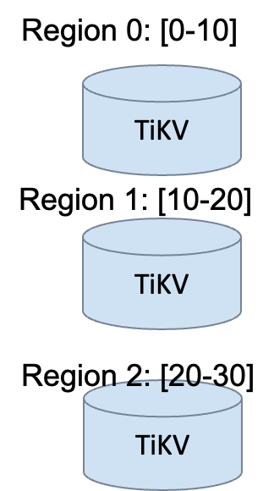
Example: (Simplified) TiDB
How to handle one region failure?
New-SQL must be available!
TiKV: TiDB’s storage engine
Key-value storage
Using RocksDB: a LSM-tree based key-value storage
File system
Assuming ext4. an inode-based file system
TiKV
RocksDB
Ext4
File system

Slide 70
Example: (Simplified) TiDB
TiKV: TiDB’s storage engine
Raft
Replicate the region on multiple tikv instances
Using Raft to ensure high availability & consistency
TiKV
Raft
Consensus
RocksDB
Key-value storage
Ext4
File system

Slide 71
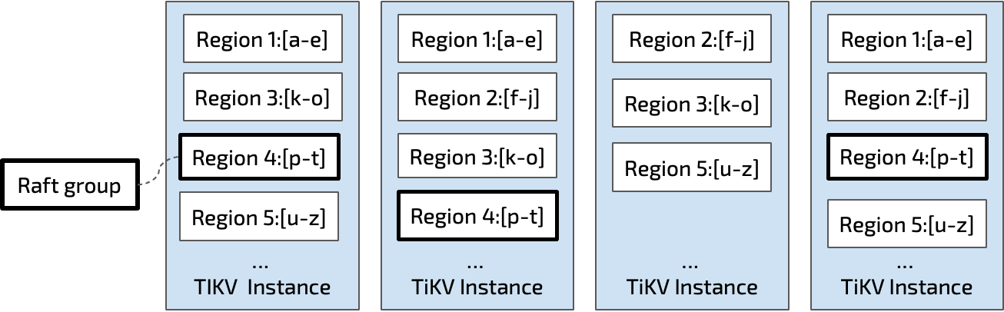
Example: (Simplified) TiDB
Each raft group can be view as a single machine
That never fail and is always consistent
TiDB uses Raft to ensure this
Can also use Paxos
e.g., Google Spanner’s choice
Logical view
Physical view
Notes:
好处：一台机器可以并发跑多个raft instance

Slide 72
Example: (Simplified) TiDB
TiKV: TiDB’s storage engine
Provides a raw key-value (or transactional key-value interface) to the others
MVCC + 2PC
2PC: to commit transaction in a distributed setting
MVCC: protocol to accelerate read in transactions
MVCC + 2PC
Transaction
TiKV
Raft
Consensus
RocksDB
Key-value storage
Ext4
File system

Slide 73
Example: (Simplified) TiDB
TiKV: TiDB’s storage engine
Provides a raw key-value (or transactional key-value interface) to the others
Transactional
from tikv_client import TransactionClient
client = TransactionClient.connect(“127.0.0.1:8888”)
txn = client.begin()
txn.put(”k1”, ”Hello”)
txn.put(”k2”, ”world”)
txn.commit()
Raw key-value

Slide 74
Example: (Simplified) TiDB
TiKV: TiDB’s storage engine
Provides a raw key-value (or transactional key-value interface) to the others
How outside word using TiDB?
Use gRPC (see lecture 05)
gRPC
RPC
MVCC + 2PC
Transaction
TiKV
Raft
Consensus
RocksDB
Key-value storage
Ext4
File system

Slide 75
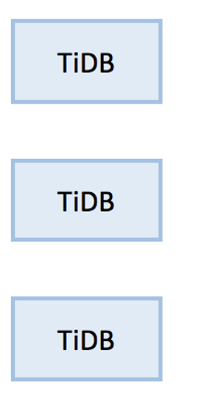

Example: (Simplified) TiDB
Supporting SQL with TiDB
Disaggregated architecture
Separate nodes that execute SQL query
Retrieve/update the data via TiKV’s key-value API
How to do the translation is out of the scope of the course
SQL
KV API
query=
select price from items
where name = “IPAD”

Slide 76
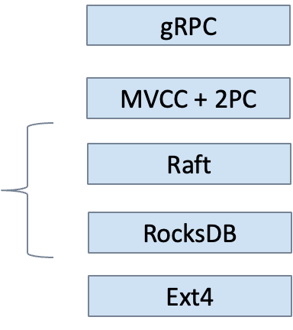
Example: (Simplified) TiDB
We have touched many important concepts that supports modern NewSQL databases, e.g.,
How to store the data
How to ensure ACID + High Availability
SQL
KV API
query=
select price from items
where name = “IPAD”

Slide 77
Detailed case study: Google Spanner

Slide 78
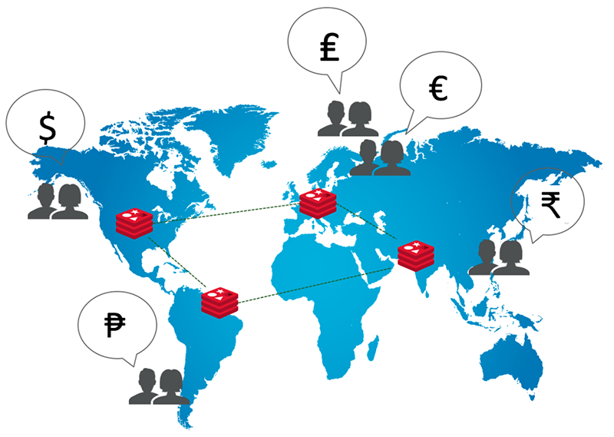
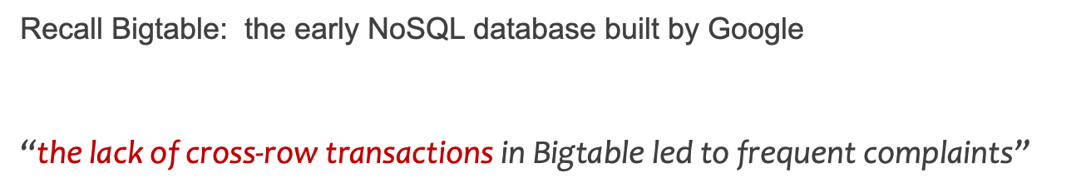
Design goals of Spanner
Data sharded & replicated over many machines & datacenters
Due to large volume of the data
For better fault tolerance & closer to the users
E.g., One datacenter crashes never affect others
Strong requirements for distributed transaction (TX)s
With ACID properties -> simplify developer’s on maintaining consistency

Slide 79
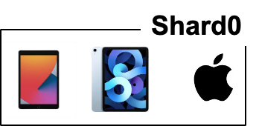
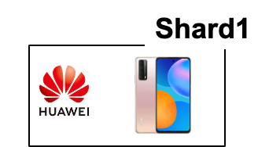

Physical layout of Spanner
Data sharded & replicated over many machines & datacenters
Tolerate machine failures in a single datacenter
User data
Server0
Data center
Replication factor = 2
Server1
Notes:
How to shard? Range or hash

Slide 80
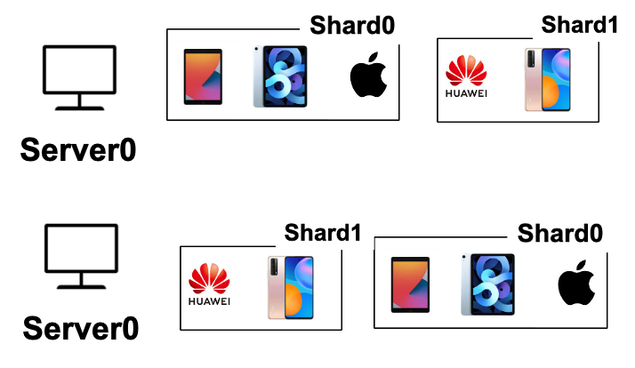

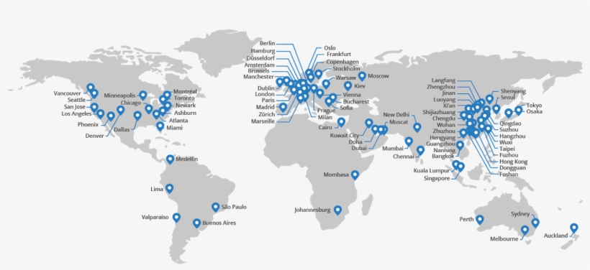
Physical layout of Spanner
Data sharded & replicated over many machines & datacenters
Tolerate machine failures across datacenters & lower request latency
User data
Server1
Server1
DC0
DC1
Data centers
Users from china can query DC at china for lower latency
Notes:
How to shard? Range or hash

Slide 81
Maintain consistency over geo-replicated data is non-trivial

Slide 82

What is the consistency goal? External consistency
External consistency is the most desirable for the programmer
Simplified definition: If T1 completes before T2 starts, T2 must see T1's writes.
Should be 100!
T1
T2
Bob.acct = 100$
Print(bob.acct)
Time
John
Bob

Slide 83

Spanner achieves external consistency
Could possibly go wrong under a distributed setting of Spanner w/o protocols
Challenge #1. consistency among replicas
The same data is replicated on machines at different datacenter(DC)s
?
T1
T2
Bob.acct = 100$
Print(bob.acct)
DC0
Bob.acct=0$
DC0
Bob.acct=100$
DC0
Bob.acct=100$
Time
DC1
Bob.acct=0$
DC1
Bob.acct=0$
DC1
Bob.acct=0$

Slide 84
Solution: PAXOS
Spanner treats replicated data via PAXOS state machines
Which internally ensures consistency & availability
E.g., on the developer’s view, each data shard is a single logic machine
And the machine never crashes (i.e., available)
DC0
Bob.acct=0$
Bob.acct=0$
DC1
Bob.acct=0$
Physical
+Paxos
Logic

Slide 85
Spanner ensures external consistency
Could possibly go wrong under a distributed setting of Spanner
Challenge #1. consistency among replicas
Challenge #2. support efficient read-only TXs across shards
Dominated the workloads in Spanner (Millions of read-write TXs vs. Billions read-only TXs at Google )
Spanner adopts some form of MVCC
Multi-version concurrency control

Slide 86
Review of MVCC (multi-version concurrency control)
Each data item has multiple versions
When accessing different versions of data, probably no conflict!
Key (high-level) idea
Writes don’t overwrite the original data
Instead, writes install new versions of data
Reads from a snapshot of data
Benefits: no lock or validation during TX’s execution
Timestamp
bankA: 100, ver: 12, pre:xx
bankA: 100
bankA: 200, ver: 10, pre:xx
Single-version
Multi-version

Slide 87
Review of MVCC (multi-version concurrency control)
Note, Spanner only uses MVCC for its read-only TX
Use 2PL for read-write TX
Why?
T is assigned a start timestamp T.sts
T
START
READ(X)
Time
T reads the biggest version of X(i), such that X(i).cts <= T.sts

Slide 88
How to assign the timestamp in MVCC?
Requirement of external consistency
If TX2 starts after TX1 commits, then
Time(TX2) > Time(TX1)
Traditional approach: global counter (logic time)
E.g., snapshot isolation
Each TX query a global counter for the time
Can trivially ensure correctness
Question:
Is global counter suitable for MVCC for spanner?

Slide 89


How to assign the time in MVCC?
Global counter
In traditional MVCC (i.e., snapshot isolation)
Question:
Is global counter suitable for MVCC?
No
1. Extra latency overhead
2. Scalability bottleneck
User data
Global counter
DC0
DC1
2
1

Slide 90
Big picture of the key techniques in Spanner
Paxos
Ensure each shard available & consistent
Where the shard is physically replicated on multiple machines
2-phase commit + 2-phase locking (for read-write transactions)
Coordinating data accesses on multiple shards
MVCC (for read-only transactions)
Efficient MVCC for read-only transactions
With synchronized physical times (TrueTime)
w/o using a global counter

Slide 91

Execution flow of read-write transaction(TX) w/o time
Read-write TX:
A TX that both reads and writes the data
tx.begin()
x = x + 1
y = y + 1
tx.end()
Client
Notes:
// what is a read-write TX
Execution flow

Slide 92
Execution flow of read-write transaction(TX) w/o time
Read-write TX:
A TX that both reads and writes the data
tx.begin()
x = x + 1
y = y + 1
tx.end()
DC0
DC1
x
X
Y
Y
Client
X,Y are sharded on two servers
Notes:
// what is a read-write TX
Execution flow

Slide 93
Execution flow of read-write transaction(TX) w/o time
Each shard is replicated
The run PAXOS to behavior as a single (logical) shard
tx.begin()
x = x + 1
y = y + 1
tx.end()
DC0
DC1
x
X
PAXOS
Y
Y
PAXOS
Client
Each shard is replicated on two DCs
Notes:
Omit local replication for simplicity

Slide 94
Execution flow of read-write transaction(TX) w/o time
Each shard is replicated w/ PAXOS
A replica is selected leader to simplify execution (no Raft introduced then)
tx.begin()
x = x + 1
y = y + 1
tx.end()
DC0
DC1
x
X
PAXOS
Y
Y
PAXOS
Leader will execute request
Start a PAXOS proposal accordingly
Client
Notes:
The leader is responsible for accepting client requests and managing the replication of the log to other servers. The data flows only in one direction: from leader to other servers.
Proposal & learned
Similar to the RAFT leader
Hold the latest value (w/o failure)

Slide 95
Execution flow of read-write transaction(TX) w/o time
Spanner uses standard 2PC & 2PL for executing read-write TX
Two-phase commit & two-phase locking
tx.begin()
x = x + 1
y = y + 1
tx.end()
DC0
DC1
x
X
PAXOS
Y
Y
PAXOS
Client

Slide 96

Execution flow of read-write transaction(TX) w/o time
Upon read, the leader will return the latest value of data
Also hold the lock on it (2PL)
tx.begin()
x = x + 1
y = y + 1
tx.end()
DC0
DC1
x
X
PAXOS
Rx
Y
Y
PAXOS
Client sends each read to Paxos leader of relevant shard
Client
Notes:
Read locks are not replicated via Paxos, so leader failure -> abort.

Slide 97
Execution flow of read-write transaction(TX) w/o time
The write will be buffered at local client
They will be written back via 2PC at the TX’s commit time
tx.begin()
x = x + 1
y = y + 1
tx.end()
DC0
DC1
write
x
X
PAXOS
Rx
Y
Y
PAXOS
Client

Slide 98
Execution flow of read-write transaction(TX) w/o time
Commit will use 2PC to write all the updates back
It will choose a shard leader as the coordinator leader
tx.begin()
x = x + 1
y = y + 1
tx.end()
DC0
DC1
x
X
PAXOS
Rx
Y
Y
PAXOS
Client
Ry

Slide 99
Execution flow of read-write transaction(TX) w/o time
The coordinator uses its PAXOS group to replicate the TX states
Why? Otherwise, the 2PC may fail if the coordinator crashes!
tx.begin()
x = x + 1
y = y + 1
tx.end()
DC0
DC1
x
X
PAXOS
Rx
Y
Y
PAXOS
Select as coordinator leader
w/ the update values
Client
Ry

Slide 100
Execution flow of read-write transaction(TX) w/o time
The coordinator leader will send the update values to the host shard leader
And each shard leader execute the prepare with PAXOS
tx.begin()
x = x + 1
y = y + 1
tx.end()
DC0
DC1
x
X
PAXOS
Prepare
Rx
Y
Y
PAXOS
Prepare
Select as coordinator leader
w/ the update values
Client
Ry

Slide 101
Execution flow of read-write transaction(TX) w/o time
If all shard leader returns the Yes to the coordinator leader
The coordinator log the commit decision (via PAXOS) & commit others
tx.begin()
x = x + 1
y = y + 1
tx.end()
DC0
DC1
x
Commit
X
PAXOS
Commit
Rx
Y
Y
PAXOS
Commit
Select as coordinator leader
w/ the update values
Yes: replicate the lock & new value
Client
Ry
Commit: update & release the lock
Notes:
Lock is replicated only at the prepare phase to improve the performance

Slide 102












Read-write TX: put it all together
Multiple physical nodes
backed by PAXOS
$$2PL+2PC+Paxos$$
$$Client$$
$$read x$$
$$Shard0$$
$$Shard1$$
$$read y$$
Client Buffer:
$$x=x+1$$
$$y=y −1$$
$$Coordiantor$$
$$perpare$$
$$perpared$$
$$perpare$$
$$perpared$$
$$commit$$
$$applied$$
$$commit$$
$$applied$$
Notes:
Prepared: get the lock, record 2PC state and Paxos state
Applied: release the lock
Prepare + Commit both require Paxos

Slide 103
Read-write TX: put it all together
Note: commit will write a new version of the data
Spanner adopts MVCC to accelerate read-only transactions
The version is the “time” of before the transaction enters commit
How to get this time is our later topics

Slide 104
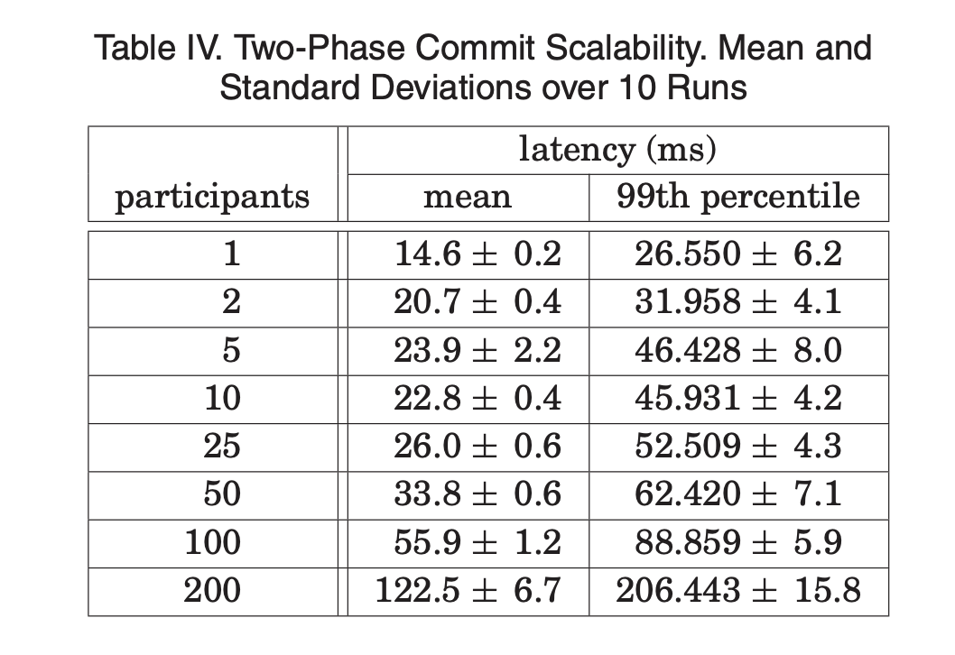
Read-write TX of Spanner so far
Standard 2PL & 2PC
Not optimized – since writes are far less common in Spanner
Maybe slow: many messages sent between machines
Also, across datacenters!

Slide 105
Read-only TX & TrueTime

Slide 106
Multi-versioning in Spanner (Standard MVCC)
Each data has multiple versions
Spanner uses the TrueTime of the last modified read-write TX
A well synchronized physical time between different coordinators
Question: how to assign the timestamp for the TXs?
Snapshot read
A read of read-only TX chooses the latest version that is <= than its time
DC0
DC1
X_{11:00}
X_{11:00}
Y_{12:00}
Y_{12:00}
Y_{10:00}
Y_{10:00}
No lock!

Slide 107
Timestamp assignment in Spanner
Read-write TX
Assigned when all locks of the TX has been acquired
i.e., the prepare phase of the TX passes (serialization point)
Read-only TX
Assigned at the start of the TX
Challenge of timing: clock synchronization for external consistency
If a read-write TX has decided to commit, then a read-only TX starts, then must ensure:
Time_{read-only} >= Time_{read-write}
Notes:
Clients can possibly be a mobile phone

Slide 108

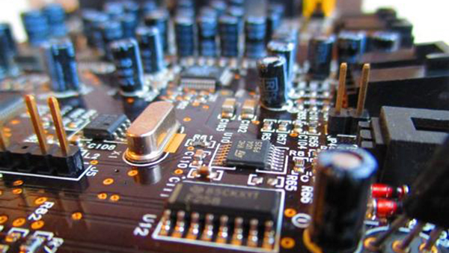
Timing: a key building block in distributed systems
Time is used by many distributed systems
e.g., cache expiration (DNS, HTTP), file synchronizers, Kerberos, ..
time intervals: how long did some operation take?
calendar time: what time/date did some event happen at?
ordering of events: in what order did some events happen?
How computer measure times?
Computer has a reasonably-fixed-frequency oscillator
E.g., quartz crystal
Represent time interval as a count of oscillator's cycles
time period = count / frequency
e.g., with a 1MHz oscillator, 1000 cycles means 1msec

Slide 109
Time Measuring
What happens when turn off the computer?
"Real-Time Clock" (RTC) chip remains powered, with battery / capacitor
Stores current calendar time, has an oscillator that increments periodically
Maintaining accurate time
Accuracy: for calendar time, need to set the clock correctly at some point
Precision: need to know oscillator frequency (drift due to age, temp, etc.)

Slide 110
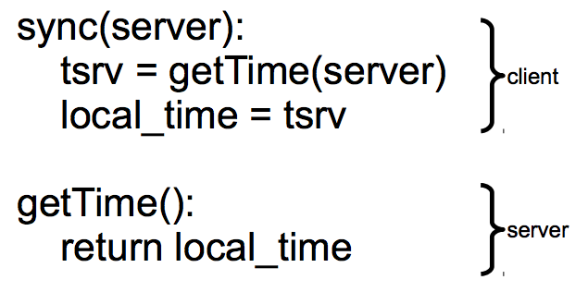
Challenge: clock synchronization
It’s hard to synchronize different machine’s clocks
the quartz clock drifts, depends on the temperature of the machine
e.g., Google assumes 17 seconds drifts assuming clocks are synchronized once per day
Common approach: synchronizing clock with NTP
Query server's time, adjust local time accordingly

Slide 111
Sync clock with NTP
Need to consider network latency
Simple estimate: RTT/2
When does this fail to work well?
Asymmetric routes, with different latency in each direction
Queuing delay, unlikely to be symmetric even for symmetric routes
Busy server might take a long time to process client's request
Can use repeated queries to average out (or estimate variance) for second two

Slide 112
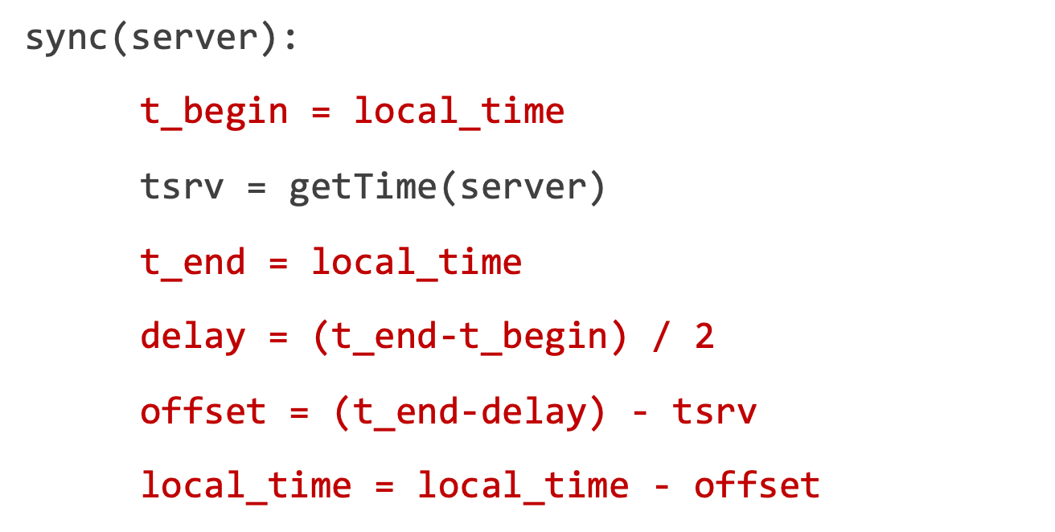
Sync clock with NTP: Estimating Network Latency
What if a computer's clock is too fast
E.g., 5 seconds ahead
Naive plan: reset it to the correct time
Can break time intervals being measured (e.g., negative interval)
Can break ordering (e.g., older files were created in the future)
"make" is particularly prone to these errors
Principle: time never goes backwards
Idea: temporarily slow down or speed up the clock
Typically, cannot adjust oscillator (fixed hardware)
Adjust oscillator frequency estimate, so counter advances faster / slower
tsrv
Server
delay
Client
tbegin
tend

Slide 113
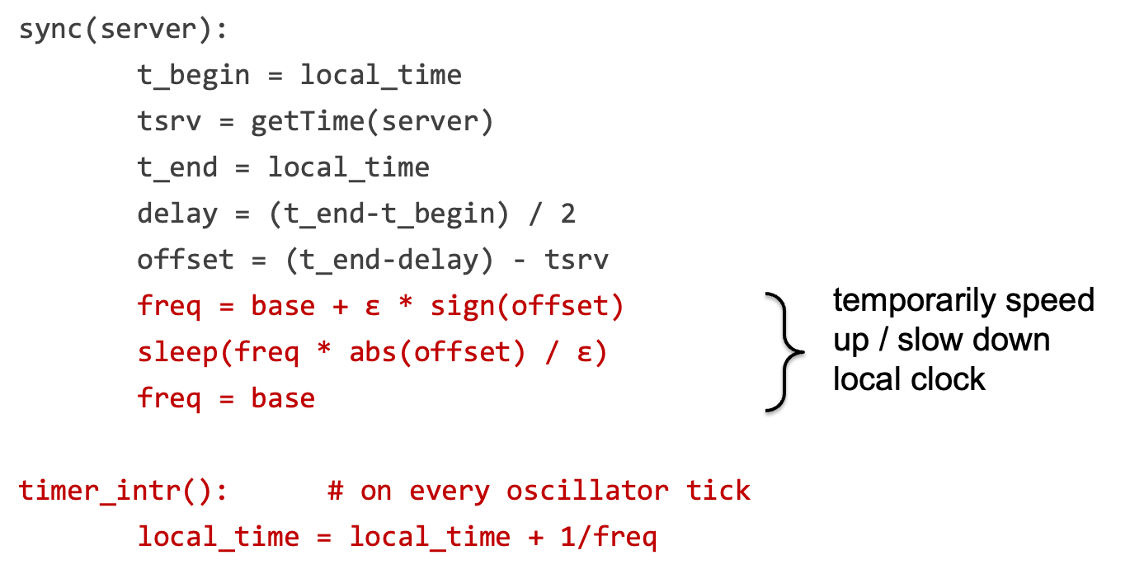
Sync clock with NTP: Estimating Network Latency

Slide 114
Drawback of NTP
No bounds on the clocks between client & server
The time of server & client is only roughly similar !
How to compare two roughly correct clock?
No way

Slide 115
TrueTime API of Spanner
TrueTime returns a time interval instead of a single point of time
The interval is bound. i.e., the time of server must be in this bound
The interval is the physical time. i.e., familiar to the user
struct timeval {
time_t tv_sec; suseconds_t tv_usec;
};
struct time_interval{
timeval Lower;
timeval Upper;
};
int gettimeofday(struct timeval *restrict tv, ...)
int get_truetime(time_interval *interval);
// Server timeval must be in [L,U]
Linux Time API
TrueTime API (Simplified)

Slide 116
Power of TrueTime API (return [L,U])
Used to implement external consistency
If a read-write TX has decided to commit, then:
Time_{read-only} >= Time_{read-write}
How to achieve this?
Commit wait for read-write TX: after acquire the commit timestamp, the coordinator wait until (U – L) and uses U as Time_{read-write}
For read-only TX, simply uses U as the read timestamp
Commit wait done, server.time1 >= U1
Time Server time
Read-write TX
L1
U1
1
Get commit time-stamp

Slide 117
Power of TrueTime API (return [L,U])
Used to implement external consistency
If a read-write TX has decided to commit, then:
Time_{read-only} >= Time_{read-write}
How to achieve this?
Commit wait for read-write TX: after acquire the commit timestamp, the coordinator wait until (U – L) and U1 as Time_{read-write}
For read-only TX, simply uses U as the read timestamp
Commit wait done, server.time1 >= U1
Time Server time
Read-write TX
L1
U1
1
2
Read-only TX
L2
U2
Get read timestamp, U2 >= server.time2

Slide 118
Power of TrueTime API (return [L,U])
Used to implement external consistency
If a read-write TX has decided to commit, then:
Time_{read-only} >= Time_{read-write}
Correctness
Time_{read-write} (U1) <= server.time1 <= server.time2 <= U2 (Time_{read-only})
Commit wait done, server.time1 >= U1
Server time
Read-write TX
L1
U1
1
2
Read-only TX
L2
U2
Get read timestamp, U2 >= server.time2

Slide 119
What if no wait?
A later executing TX can get a smaller timestamp!
E.g., T1’s timestamp (U1) can be larger than T2’s timestamp (U2)
Problem: violating the external consistency
T1 get timestamp (U1)
T1 commit
Server time
Read-write TX
L1
U1
Read-only TX
L2
U2
T2 get timestamp (U2)

Slide 120
How to achieve the bound of TrueTime?

Slide 121
TrueTime: how to achieve the bound?
The bound is relative to the time servers as the ground truth
For simplicity, we first assume there is only one time server
Spanner adopts a variant of Marzullo’s algorithm^{[1]}
Problem statement
If the local clock of client is T, what is the time interval of the server?
[1] Maintaining the Time in a Distributed System
Notes:
Ma zu luo

Slide 122
TrueTime: how to calculate the bound?
Problem statement
If the local clock of client is T, what is the time interval of server?
High-level idea: send RPC to the server for the query as the measurements!
Similar as NTP
Before query the time, periodically sync with the time server
Sync
What is the time?
tsrv
T_{s}
Time
Server
T
Client
tbegin
tend
get_truetime()

Slide 123
TrueTime: how to calculate the bound?
Simplification: assuming server advances in the same speed as clients
Suppose the start time at client & server is T_{c} and T_{s}, respectively
Then after Δ time, the clock of client & server would be T_{c} + Δ and T_{s} + Δ
Since we know the tsrv, the key question is how to calculate the interval
Sync
tsrv
T_{s}
Time
Server
Interval
T
Client
tbegin
tend
get_truetime()

Slide 124
TrueTime: how to calculate the bound?
Since we know the tsrv, the key question is how to calculate the interval
Interval >= T – tend
Interval <= T – tbegin
T_{s} = tsrv + Interval
T – tend + tsrv <= T_{s} <= T – tbegin + tsrv (based on our simplification)
Question: what if there is a drift between client & server?
Sync
tsrv
T_{s}
Time
Server
Interval
T
Client
tbegin
tend

Slide 125
TrueTime: how to calculate the bound?
Simplification: assuming server advances in the same speed as clients
T – tend + tsrv <= T_{s} <= T – tbegin + tsrv (based on our simplification)
Assume a fixed ε drift rate between client & server
After t time, the drift between client & server is (1 + ε) or (1 - ε)
Spanner assumes a fixed as 200us / second
Then the interval is regulated as
(T – tend) * (1 - ε) + tsrv <= T_{s} <= (T – tbegin) * (1 + ε) + tsrv
Done
Solution: regulate with the drift rate
L
U
Question: does a single time server design fit spanner’s setup?

Slide 126
TrueTime adopts multiple time servers
timemaster
timemaster
timemaster
Question: how to keep different timemasters sync?
timemaster
timemaster
timemaster
Client
Datacenter 1
Datacenter 2
…
Datacenter n
Called timemaster (☺) in Spanner
Notes:
Marzullo’s algorithm also considers the case of multiple time servers

Slide 127
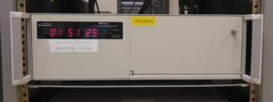
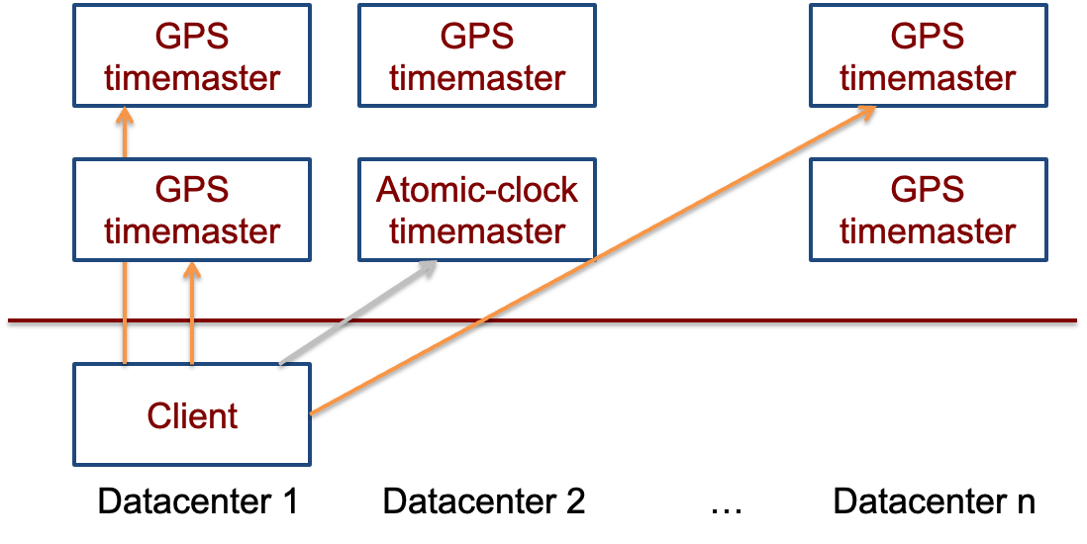
TrueTime adopts multiple time servers
Time servers are backed by GPS & atomic clocks
High-precision clocks
E.g., 1 second drift after 20,000,000 year
Atomic clocks are synchronized with each other

Slide 128
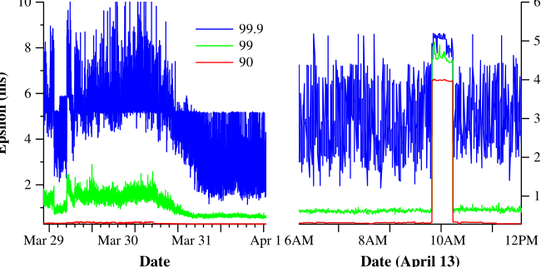
Final takeaway of TrueTime: Network-Induced Uncertainty
Interval of T
[ (T – tend) * (1 - ε) + tsrv, (T – tbegin) * (1 + ε) + tsrv]
tsrv – tbegin is rougly estimated as the network delay
Can have spikes if timemasters are out of services
Maintain 2 timemasters
tsrv
Server
delay
Client
tbegin
tend

Slide 129
Summary
Reify clock uncertainty in time APIs
Known unknowns are better than unknown unknowns
Rethink algorithms (TX’s concurrency control) to make use of uncertainty
Stronger semantics are achievable
Greater scale != weaker semantics

